Slide 1
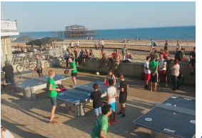
Feedback from people with learning disabilities
Image
Access to Sport and Leisure Facilities in the City

Slide 2
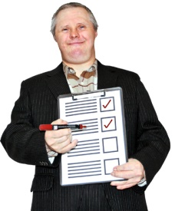
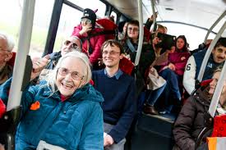
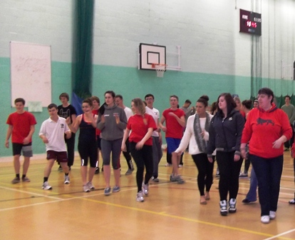
What worked well
People who are already taking part enjoy what they are doing.
People get to do a mixture of things through their day services.
Image

Slide 3
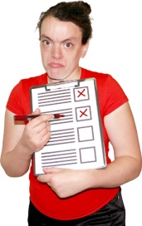
Issue 1
Website information is not accessible.
Image
Speak Out is working with My Life
Website to make this better
Other websites could look listen to what people with learning disabilities say

Slide 4
Issue 2
Information about sports and leisure is not getting to people with learning disabilities.
Easy read leaflets need to go to support workers, care staff, families, carers and social workers.

Slide 5
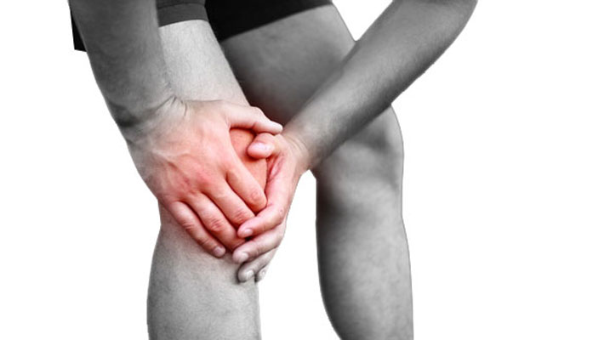
Issue 3
Some people have physical conditions that make it hard to exercise.
Image
People would like to get information about what exercise is safe for them.
They want to know when and where they can do activities that are right for them.

Slide 6
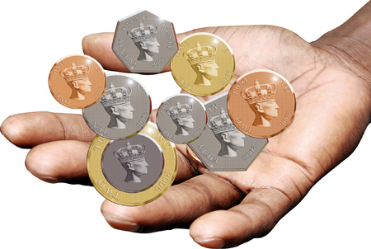
Issue 4
People say activities cost too much.
They do not know what discounts they can have.
Image
Make sure information about discounts and free activities is clear and reaches people.

Slide 7
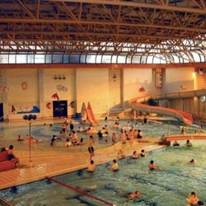
Issue 5
People find new activities and crowded places very stressful.
Image
Take into account that people need extra support to start a new activity.
Provide information about ‘quiet’ times.

Slide 8
Issue 6
People feel safer doing activities with other people with learning disabilities.
Image
Offer learning disability sessions for people who do not have a day service.

Slide 9
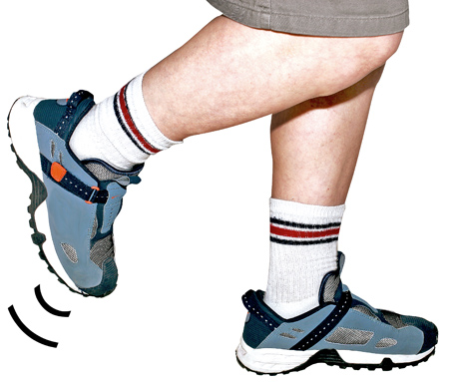
Issue 7
People with epilepsy need extra support to exercise safely.
Give people with learning disabilities information about what support is on hand in leisure centres.

Slide 10
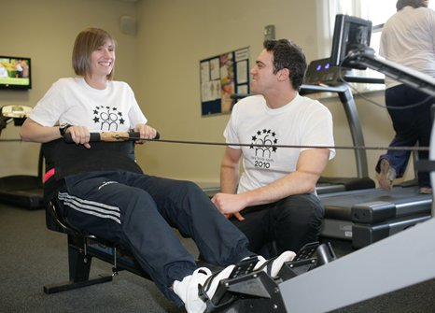
Issue 8
People who live independently do not have the confidence to use mainstream activities alone.
It would be good to have a Sports Buddy project.

